Slide 1
Hackathon’25 : Solve Rubik’s Cube
BY : Jeba Selvan Andrew P

Slide 2
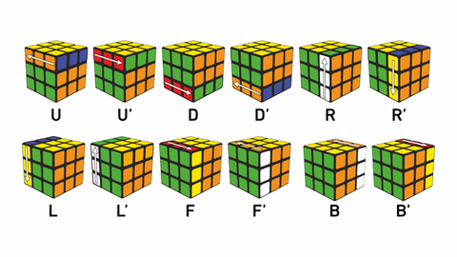
Solve Rubik’s Cube
Overview
Participants are challenged to design and implement an algorithm that can solve a standard 3x3 Rubik’s Cube from any scrambled state. The solution must mimic the real-world logic of solving a cube through a sequence of valid moves.
What We’re Looking For : 🔍
Problem-Solving Approach
How do you break down the problem?
How do you model the cube’s state and transitions?
Use of Data Structures
How do you represent the cube internally (e.g., arrays, trees, graphs)?
Use of efficient structures to track states and operations.
State Prediction Logic
Ability to track and predict cube state after each move.
Design of a move engine to simulate rotations and track permutations.
Algorithm Efficiency
How fast can your solution reach the solved state?
Complexity (time and space) of your algorithm.
Bonus Evaluation Areas
Creativity in solution design.
Visual simulation or cube UI (optional but Wow factor).
Scalability for different cube sizes (2x2, 4x4, etc.) : Optional
Deliverables:
Working algorithm (code)
Brief walkthrough/presentation of your approach
Output example(s) from your solver
It’s Not Just a Puzzle - It’s a Test of Mind, Math, and Moves!

Slide 3
Structured Evolutionary Cube Solver(SECS ++)

Slide 4
My Approach to the problem
The method we used to solve the cube is “Phased Solving”
we divided the issue into three rational, consecutive stages: 1.Cross - used to build initial foundation 2.F2L(First Two Layer) – the majority of the cube is solved in this 3.Last layer – completion using the final pattern analyzer
This process helps us to reduce the complexity of the problem at every single level to give a more focused and efficient search that is more important in this high possibility problem

Slide 5
Addressing the Research Gap
The issue with the current solvers is that they use brute force algorithms more frequently or have a large lookup table which makes the algorithm more complex and difficult to analyse and explain
To address this gap our SECS ++ comes with a solution by presenting the framework of 1.Custom Heuristics 2.Adaptive search by integrating A* algorithm 3. Balances Interpretability and Efficiency by the combination of intelligent search algorithm with a phased structured approach

Slide 6
Technical foundation
The cube representation is done by a flat dictonary data structure by employing each of the colour value as a sticker ina key value pair (eg ..,‘U0’ , ‘b’)
The need to use a flat dictonary is for the following reasons 1. Speed: It offers immediate, O(1) access to the color of any sticker, which is essential for functionality. 2. Clarity & Safety: Safe, immutable state copies are possible, and the model is easily debugged due to its human- readable nature.

Slide 7
Mathematical Foundation : A* Search Algorithm
The central engine The robust A* (A-star) search algorithm, a fundamental component of AI pathfinding, is at the core of our solver. Because it searches purposefully rather than aimlessly, A* is better than more basic search techniques.
The A * algorithm works cleverly by minimizing the total cost function, f(n), for each possible cube state n in order to determine the most effective route to a solution.
The A* Formula:f(n)=g(n)+cubeeval(n)
Where, g(n) - path cost cubeeval(n) – custom heuristic function

Slide 8
Mathematical Foundation : cubeeval(n)
The key innovation of my project is the custom heuristic which iv’e designed and named as the cubeeval() function
Our function combines two distinct metrics to assess the cube's state 1.Misalignment(H diff​ ): A straightforward tally of the stickers that are positioned incorrectly. 2.Entropy(E) : measure the color "disorder" on each face.
The Heuristic Formula: cubeeval(n)=a⋅Hdiff​(n)+b⋅E(n) where, a , b are the turnable weights that are calculated for each phase

Slide 9
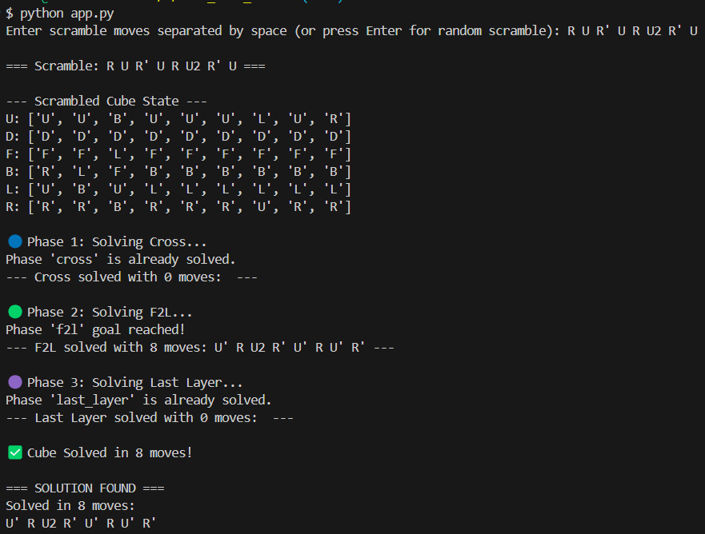
Combination and Final Result
The sophisticated, specially-crafted cubeeval(n) heuristic was combined with the reliable, pathfinding framework of A* to produce the final, successful solver. The solver can navigate the cube's 43 quintillion possible states with intelligence

Slide 10
Algorithm Limitations & Future Work
The First Two Layers (F2L) phase's enormous computational complexity is the solver's main drawback. A scramble's difficulty lies not only in its duration but also in the particular state it induces.
Low-to-medium complexity scrambles, such as our 8-move example, can be consistently solved by our A* search.The search may go beyond its set depth (max_steps) for extremely complicated scrambles before a solution is found.
An entirely algorithmic F2L might be included in a later version.

Slide 11
Test Cases
8 move scramble R U R' U R U2 R’ U
5 move scramble F R U R' F’
6 move scramble R U R' U R U’
3 move Scramble R R’ U
4 move Scramble F U L D'

